Slide 1
Fire Alarm
"Sensing Heat, Securing Lives."

Slide 2
Introduction
Fire Alarm fire alarm is an electronic safety system that detects fire and gives a warning.
It consists of a sensor, controller, buzzer, LED, and power supply.
In our project, we use a flame sensor to detect fire. When the flame sensor detects a flame, it sends a signal to the Arduino.
The Arduino processes the signal and turns ON the buzzer and LED.
So, the basic working is: Flame → Flame Sensor → Arduino → Buzzer + LED The main purpose of a fire alarm is to give an early warning and help keep people safe.

Slide 3
Working
Detection: The IR receiver on the red module monitors the surroundings for infrared light emitted by fire.
Signal: When a flame is detected within range, the module's digital output pin (DO) changes state and notifies Pin 2 on the Arduino.
Action: The Arduino code reads the signal from Pin 2 and immediately sets:
Pin 8 HIGH to sound the buzzer.
Pin 9 HIGH to light up the red LED.
Reset: Once the flame is removed, the sensor signal clears, and the Arduino turns off the LED and buzzer.

Slide 4
Applications
This prototype serves as a foundational building block for practical safety and automation systems, including smart home security alarms, fire/flame detectors, or robotics obstacle avoidance.
Future enhancements could include integrating an LCD display to show system status or adding a Wi-Fi/Bluetooth module (e.g., ESP8266/ESP32) to send remote notifications to a smartphone.

Slide 5
Advantages
Early Flame Detection: Provides instant audio-visual warnings (buzzer and LED) as soon as infrared light from fire is detected.
Low Cost & Accessible: Built using inexpensive components like an Arduino Uno, flame sensor module, buzzer, and LED, making it budget-friendly.
Simple Circuit Design: Easy to construct, troubleshoot, and demonstrate for school, college, or prototype projects.
Programmable & Scalable: The Arduino code can easily be updated to add features like GSM alerts (SMS notifications), temperature sensors (DHT11)

Slide 6
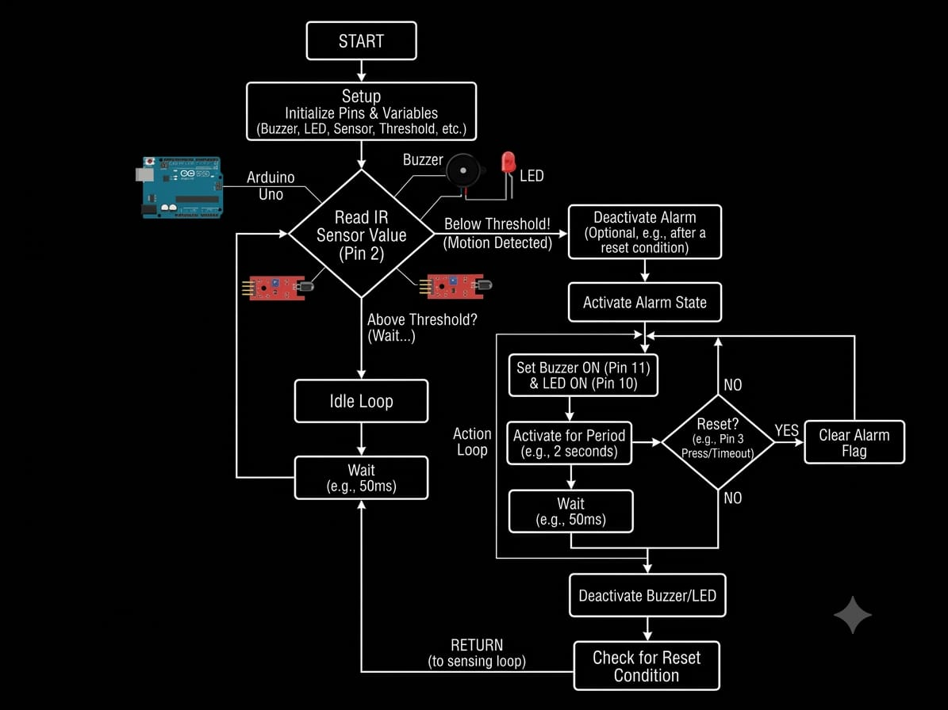

Slide 7
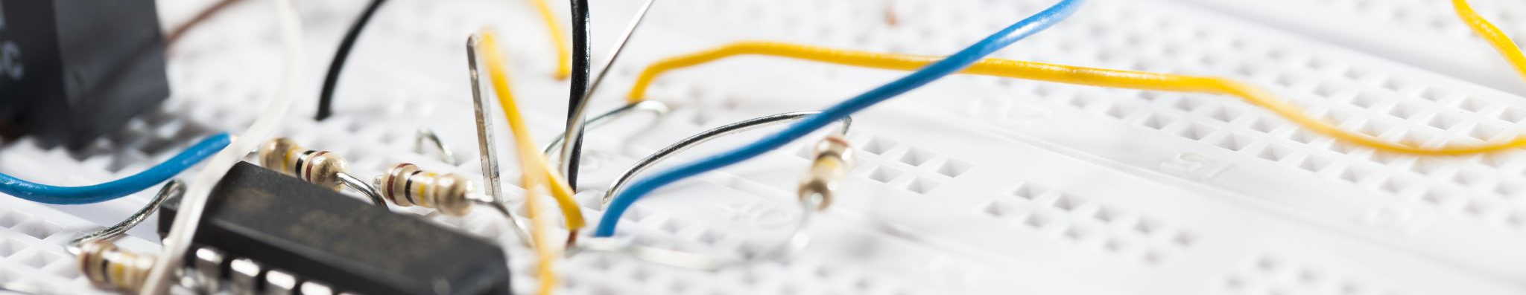
Core Components Overview
Arduino Uno
Flame Sensor
Piezo Buzzer
LED
Jumper Wires

Slide 8
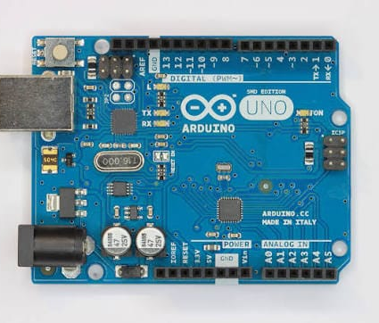
Arduino UNO
Function: Acts as the main microcontroller/brain of the circuit.
Role: It reads digital or analog signals from the sensor, executes the uploaded code logic, and controls output devices like the LED and buzzer based on those inputs

Slide 9
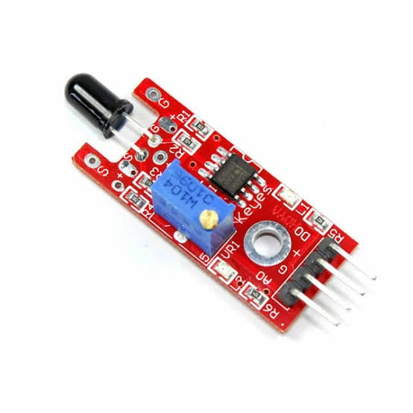

Flame Sensor
Role: Input device (Detector).
​Function: Detects infrared light emitted by fire or light sources.
​Key Features:
​IR Receiver LED (Black Bulb): Senses the light/flame.
​Potentiometer (Blue Knob): Adjusts the detection sensitivity.
​Connections: Powered via 5V and GND pins, while sending its detection signal to digital pin 2.

Slide 10
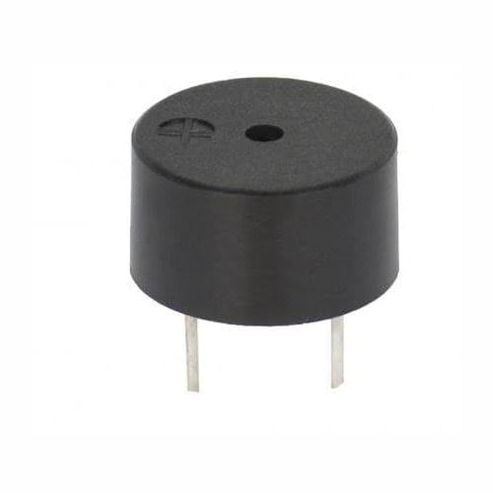
Piezo Buzzer
Role: Audio output (Alert/Alarm).
Function: Generates a sound or alarm tone when it receives a voltage signal. In this setup, it triggers an acoustic alarm when the sensor detects a flame.
Connections: Connected between digital pin 8 and GND

Slide 11
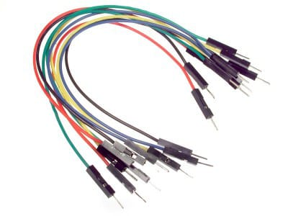
Jumper wires
Jumper wires are short electrical cables with a pin or connector at each end, categorized into male-to-male, male-to-female, and female-to-female types.
They are used to build and test circuits on breadboards or connect components to microcontrollers like Arduino without any soldering

Slide 12
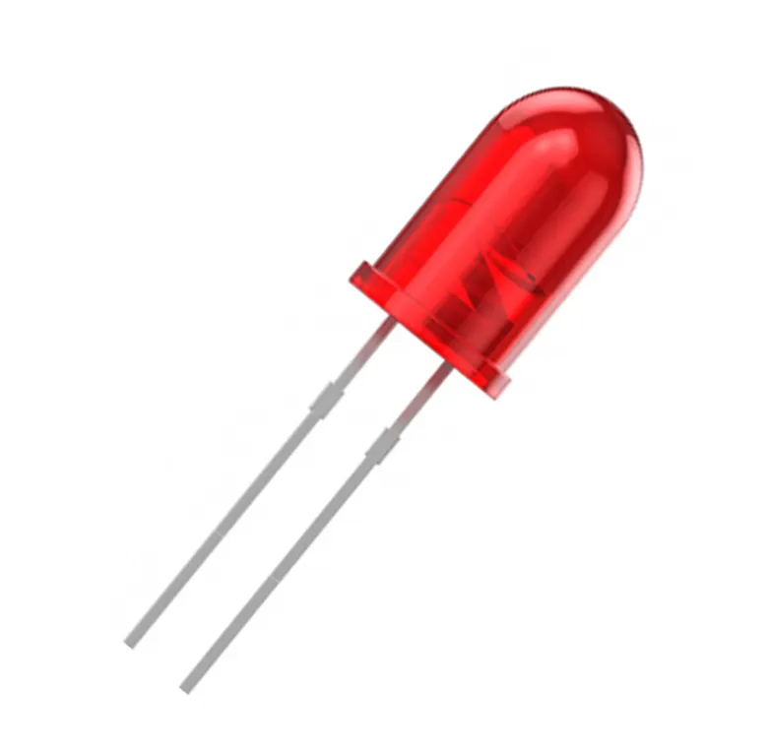
LED
Role: Visual output (Indicator).
Function: Lights up to provide a visual warning when a specific condition (e.g., flame detection) is met.
Connections: Anode (long leg) connects to digital pin 9 through a resistor, and cathode (short leg) connects to GND.

Slide 13

Core Concept
The circuit uses an IR Flame Sensor to detect fire/heat radiation. When a flame is detected, the Arduino triggers a visual alert (LED) and an audio alert (Buzzer).
Key Connections
Flame Sensor Module:
Powered by Arduino’s 5V and GND.
DO (Digital Output) pin is connected to Digital Pin 2 on the Arduino to send a signal when fire is detected.
Buzzer:
Positive terminal connected to Digital Pin 8; negative terminal connected to GND.
LED:
Anode (positive) connected to Digital Pin 9 through a $220 Ω$current-limiting resistor; cathode (negative) connected to GND.

Slide 14
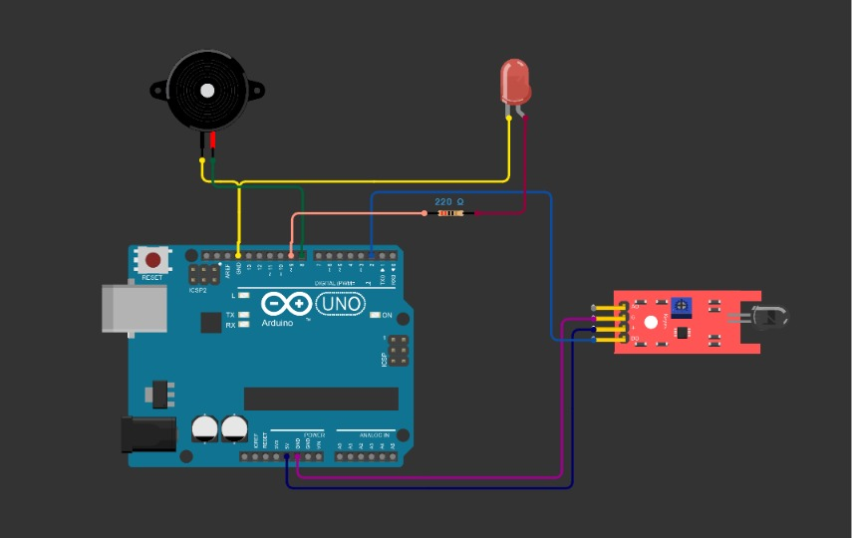
Circuit Design

Slide 15

PROJECT CODE

Slide 16
Conclusion
This project successfully demonstrates the design and implementation of an Arduino-based automated detection and alert system.
By interfacing a digital sensor module (such as an IR proximity or flame sensor) with an Arduino Uno microcontroller, the system effectively processes input signals in real time to trigger immediate audiovisual warnings via an LED indicator and a piezo buzzer.

Slide 17
…
Thank you

